Slide 1

Sprocket Central Pty Ltd
Data analytics approach
Arundhati Panigrahi

Slide 2
Agenda
Introduction
Data Exploration
Model Development
Interpretation

Slide 3
Introduction
Customers analysis
Age distributions
Number of bike purchases in 3 years/percentages purchases
Job industry category.
Wealth segments
Number of cars own in each state

Slide 4
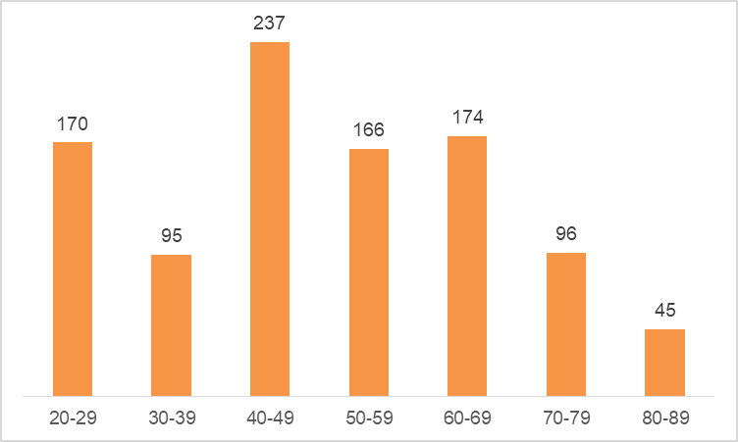
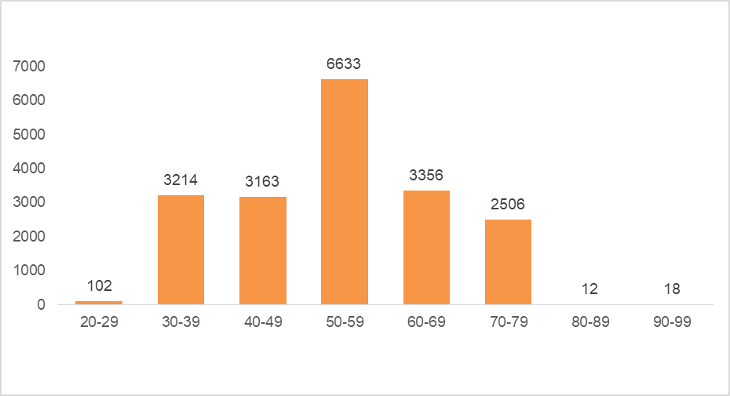
Data Exploration
Customers’ age distribution
new
As we can see, mostly our new customers are between 20 to 49 years old.
Number of customers from 40 to 49 years old has big drops on percentages.
There is a slight increase in the number of customers over 59 years old in terms of percentages
It looks like the percentages of under 25 years old do not really change.
old

Slide 5
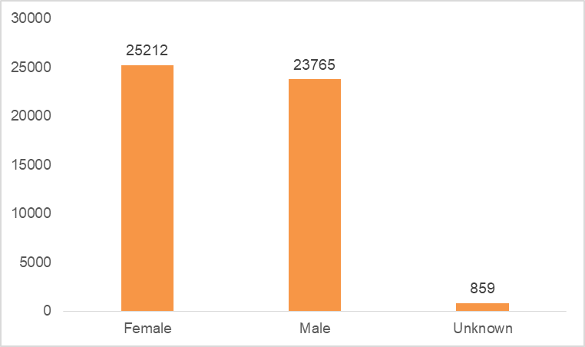
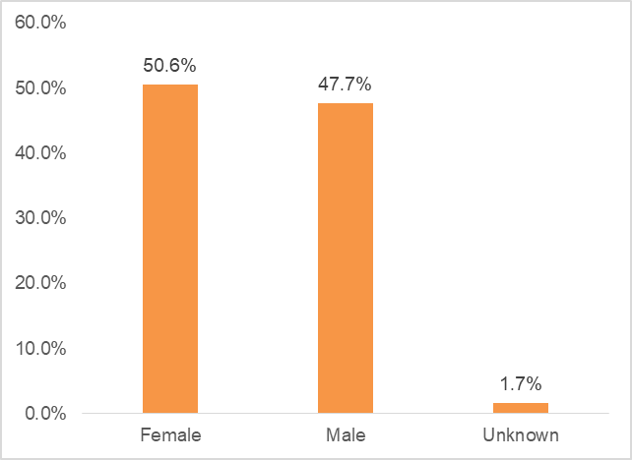
Model Development
Bike purchases last 3 years
As we can see, our new customers are mostly Female with 50.6% purchases with a total of 25,212 bikes
Male contributed to 47.7% purchases with 23,765 bikes
So we should focus on advertises on Female customers than Male customers

Slide 6
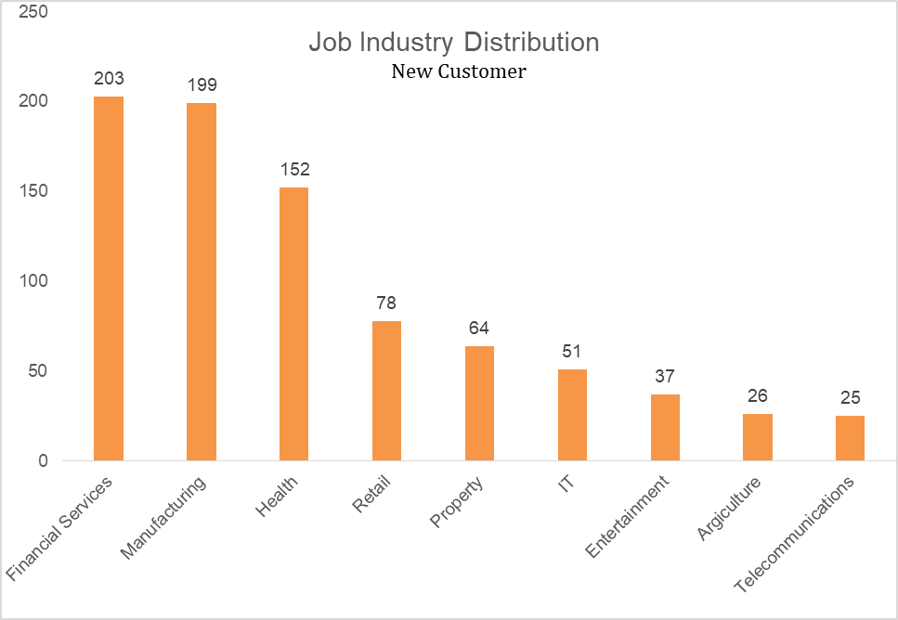
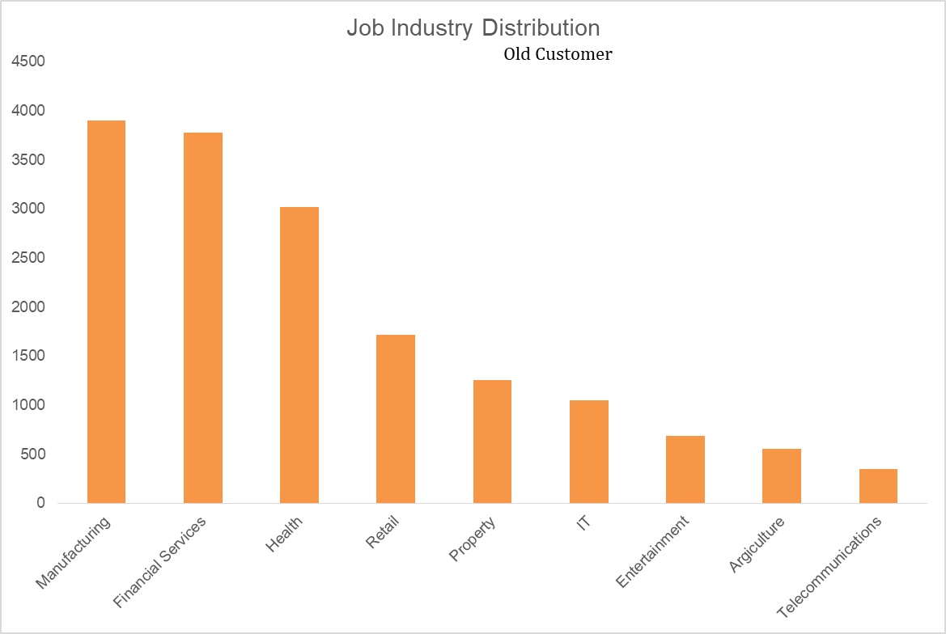
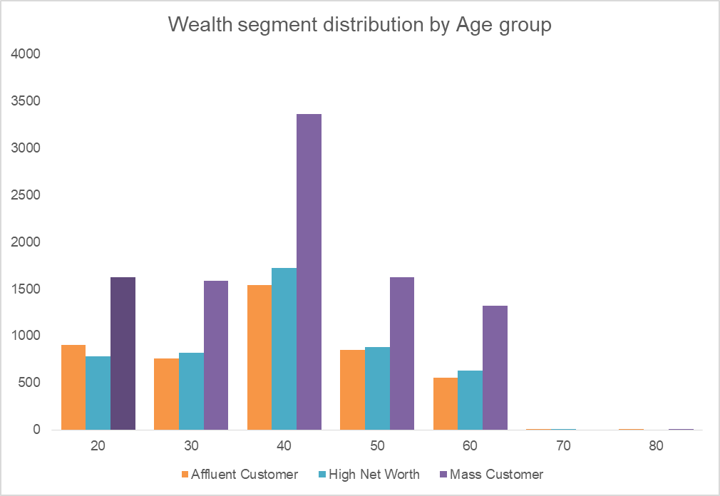
Interpretation
Job industry category
Mostly our new customers are in the Finance industry and our Manufacturing customers are still on top 2.
The rest industries is still the same
Wealth segments
In all ages, the number of Mass Customers is the highest so we should focus on this social class.
After that, we should focus on High Net Customers.
Then Affluent Customers but the mostly second and third quadrant

Slide 7
Interpretation
Numbers of cars owned
NSW should be considered the most since the number of customers who don’t own cars is significantly larger than that own.
VIC and QLD have more customers who own cars than those who don’t, but we can try to have something so that those who own cars will buy bikes.

